Slide 1

Unit 3

Slide 2
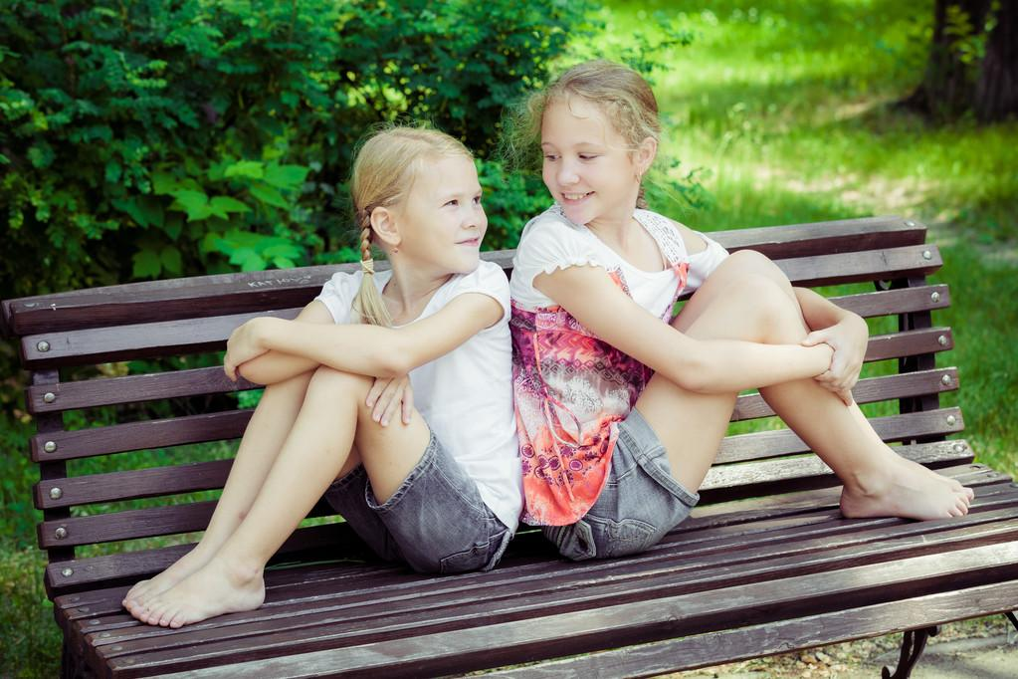
Unit 3
I’m more outgoing than my sister.

Slide 3
Review
形容词和副词比较级的规则变化规律
 | 规则变化规律 | 原级 | 比较级
单音节词/ 双音节词 |  | fast
 |  | fine
 |  | thin
 |  | funny
多音节词/双音节词 |  | wonderful outgoing loudly
一般在词尾+er
faster
finer
thinner
funnier
more wonderful
more outgoing
more loudly
以e结尾的词+r
重读闭音节词词尾只有一个辅音字母，双写辅音字母+er
部分辅音字母+y的双音节词，把y变i+er
more+词

Slide 4
Review
形容词和副词比较级的不规则变化规律
原级 | 比较级
good/well
bad/badly | worse
many/much
little
far | farther/further
better
more
less

Slide 5



Slide 6
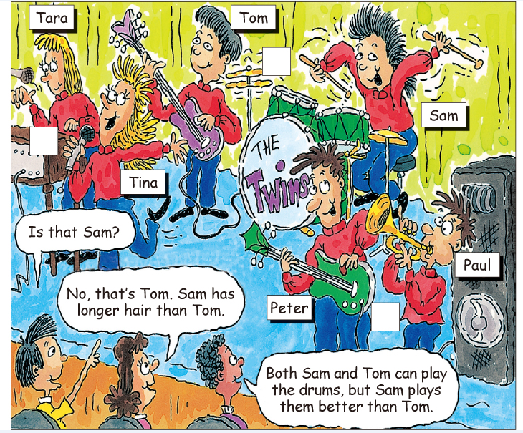
Lead in
This is a concert(音乐会) played by 3 pairs of twins.
Twins look similar, but actually the one twin is different from the other one.
Let’s have a look and compare(对比) them.
[ˈsɪmələ]

Slide 7
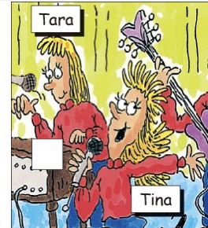
Presentation
Try to compare(对比) the twins.
— What do they do?
— Tara plays the piano and sings.
Tina sings, too./
Both Tara and Tina sing.
—Who is more outgoing?
—Tina is more outgoing than Tara.
(Is Tina more outgoing than Tara?)
—Guess, who sings more loudly?
—Tina sings more loudly than Tara.
(Does Tara sing more loudly than Tina?)
sing more loudly
be more outgoing
A+V+形容词/副词比较级+than+B.

Slide 8
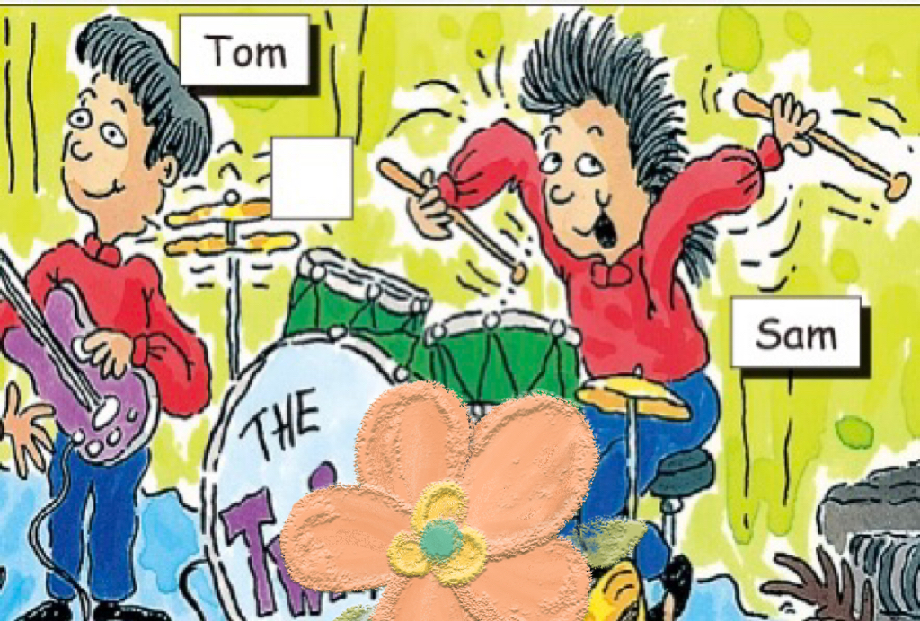
Presentation
Try to compare(对比) the twins.
— What do they do?
— Tom plays the guitar.
Sam plays the drums.
— Who plays the drums better?
— Sam plays the drums better than Tom.
(Does Sam play the drums better than Tom?)
—What do they look like?
—Tom has short hair.
Sam has long hair.
Sam has longer hair than Tom.
(Does Sam have longer hair than Tom?)
play the drums better
have longer hair

Slide 9
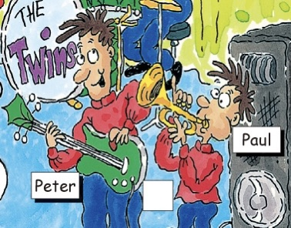
Presentation
Try to compare(对比) the twins.
—What do they look like?
—Peter is tall and heavy.
Paul is short and thin.
Peter is taller and heavier than Paul.
Paul is shorter and thinner than Peter.
Peter’s hair is as short as Paul’s.
(Is Peter’s hair as short as Paul’s?)
be heavier；be taller
A+V+as+副词/形容词+as+B.

Slide 10
Pair work
Ask and answer questions about the twins.
have longer hair；
play the drums better
sing more loudly；
be more outgoing
be heavier/thinner；be taller/shorter
A: Is Tara taller than Tina?
B: No, she isn’t. Tina is taller than Tara.
A: Does Tom play the drums better than Sam?
B: No, he doesn’t. Sam plays the drums better than Tom.

Slide 11
Compare A with B with -er, more and as ... as.
A+V+形容词/副词比较级+than+B.
Tina sings more loudly than Tara.
Tina唱歌唱得比Tara更大声。
Does Tara sing more loudly than Tina?
Tara唱歌唱得比Tara更大声吗？
Tina is more outgoing than Tara.
Tina比Tara更活泼。
Is Tina more outgoing than Tara?
Tina比Tara更活泼吗？

Slide 12
Compare A with B with -er, more and as ... as.
A+V+as+形容词/副词+as+B.
Peter’s hair is as short as Paul’s.
Peter的头发和Paul的一样短。
Is Peter’s hair as short as Paul’s?
Peter的头发和Paul的一样短吗？
Tom plays the guitar as well as Peter.
Tom弹吉他弹得和Peter一样好。
Does Tom play the guitar as well as Peter?
Tom弹吉他弹得和Peter一样好吗？

Slide 13



Match each word with its opposite(反义词).
tall
thin
long hair
quietly
loudly
short hair
heavy
short

Slide 14



Listen and number the pairs of twins in the picture [1-3].
1
2
3

Slide 15
Listen to the conversations and fill in the blanks.
Conversation 1
Boy 1: Is that Sam playing the guitar?
Girl: No, that’s Tom. Sam ___ _____ _____ _____ Tom.
Boy 2: Both Tom and Sam can play the drums, but Sam _____ them ______ _____Tom.
Conversation 2
Boy: That’s Tara, isn’t it?
Girl: No, it isn’t. It’s Tina. Tina ____ _____ _____ Tara. And she also ____ _____ _____ _____ Tara.
Conversation 3
Boy: Is that Paul?
Girl: No, that’s Peter. Peter’s heavier than Paul. And Paul’s shorter than Peter.
has longer hair than
plays
better than
is taller than
sings more loudly than

Slide 17
Exercise
Complete the sentences.
1. Tom比Sam更聪明吗？
Is Tom _______ _______ Sam?
不是。Sam比Tom更聪明。
No, he isn’t. Sam is _______ _______ Tom.
smarter than
smarter than

Slide 18
2. Tara比Tina更外向吗？
Is Tara _______ _________ _______ Tina?
不是。Tina比Tara更外向。
No, she isn’t. Tina is ________ ________ ______ Tara.
3. 你和你姐姐一样友善吗？
______ you ______ friendly ______ your sister?
不是。我更友善一些。
No, I’m not. I’m __________.
more outgoing than
more outgoing than
Are
as as
friendlier

Slide 19
4. Tara和Tina一样努力吗?
Does Tara work ______ _____ ______ Tina?
是的。
Yes, she does.
5. 谁在学校更努力一些？
Who’s _________ _____________ at school?
Tina认为她比我更努力。
Tina thinks she _______ ________ than me.
as hard as
more hard-working
works harder

Slide 20


Are the words in the box used with –(i)er or more?Complete the chart.
-er / -ier | more
friendly — friendlier | outgoing — more outgoing
funny
friendly
outgoing
hard-working
smart
lazy
(run) fast
(jump) high
(work) hard
(get up) early
funny — funnier
hard-working
— more hard-working
smart — smarter
lazy — lazier
fast — faster
high — higher
hard — harder
early — earlier

Slide 21

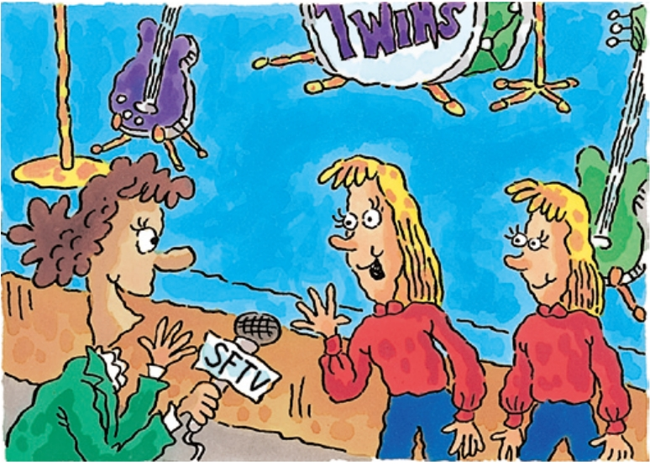
Listen. How are Tina and Tara different? Fill in the boxes.
Tina … | Tara …
1. is more outgoing than Tara. | 1.works as hard as Tina.
2. | 2.
3.
4.
5.
6.
7.
is friendlier than Tara.
gets up earlier than Tina.
is funnier than Tara.
funnier
friendlier
more outgoing
more hard-working
smarter
lazier
(run) faster
(jump) higher
(work) harder
(get up) earlier
can run faster than Tara.
can jump higher than Tara.
is smarter than Tara.
is lazier than Tara.

Slide 22
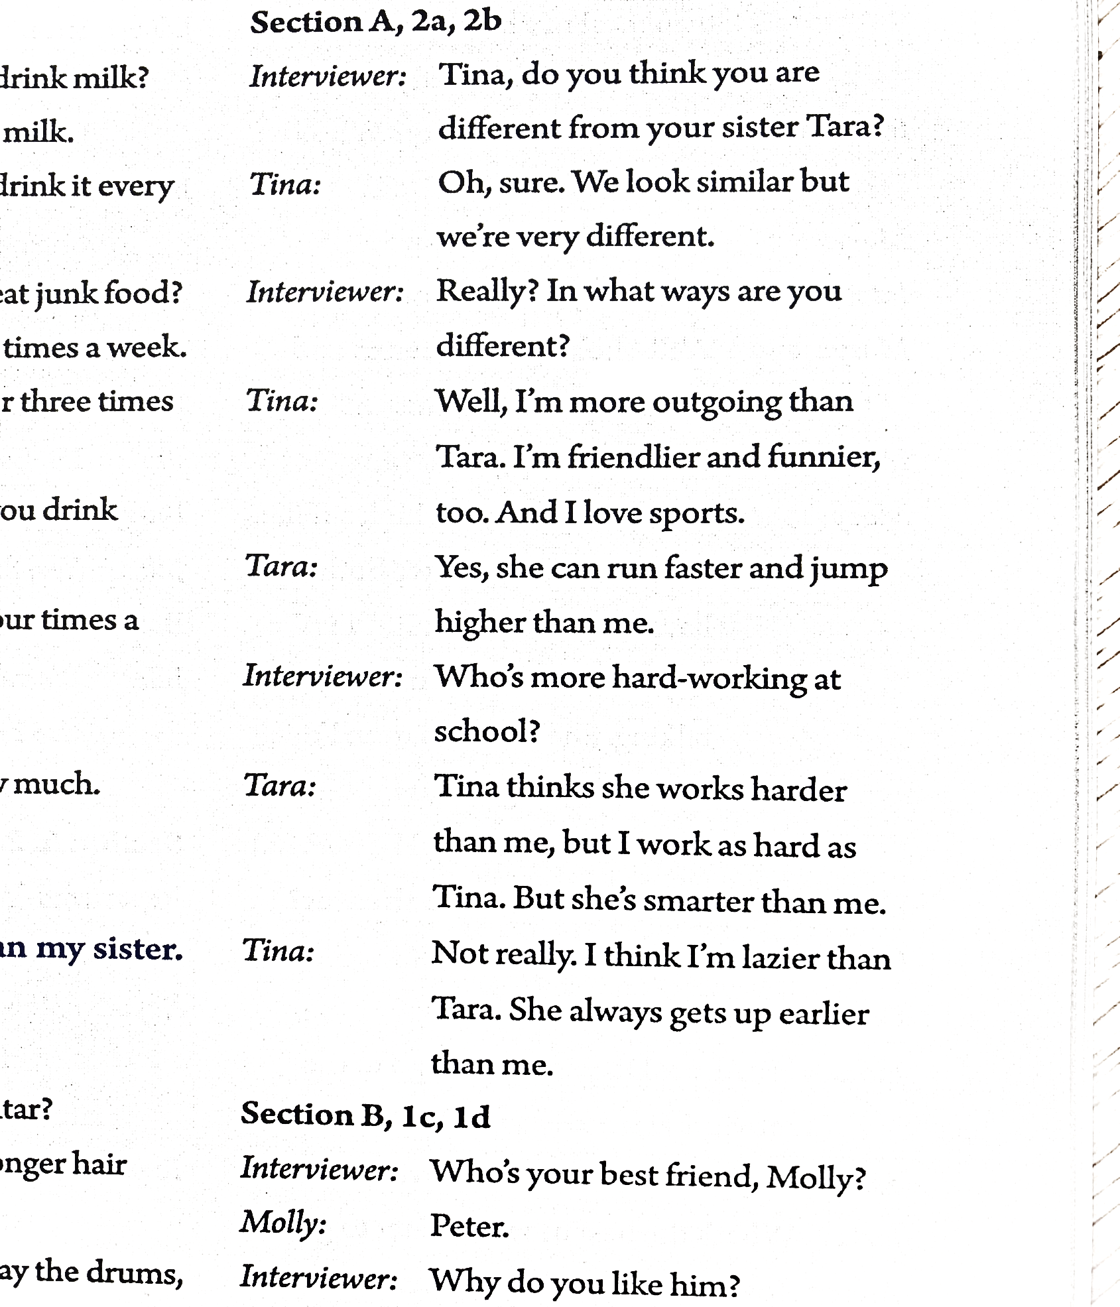
听力原文

Slide 23
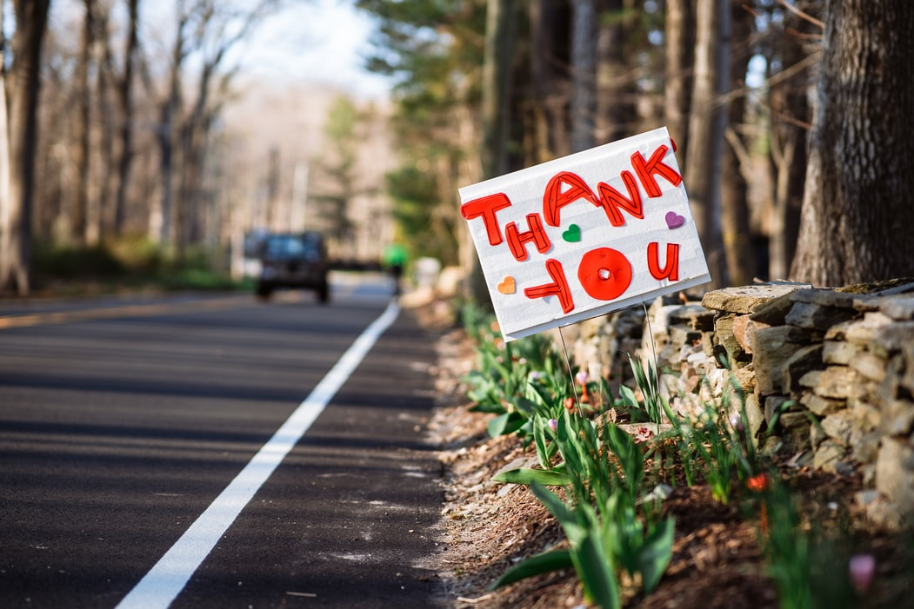

Slide 24
both 两者都（adj/pron）
用法：她的2个哥哥都是老师。
Both her 2 brothers are teachers.
Both of her 2 brothers are teachers.
Her 2 brothers both are teachers.
练习：我们两个都想加入体育俱乐部。
Both of us want to join the sports club.
We both want to join the sports club.
用法：Tom 和Jack都是老师。
Both Tom and Jack are teachers.

Slide 26
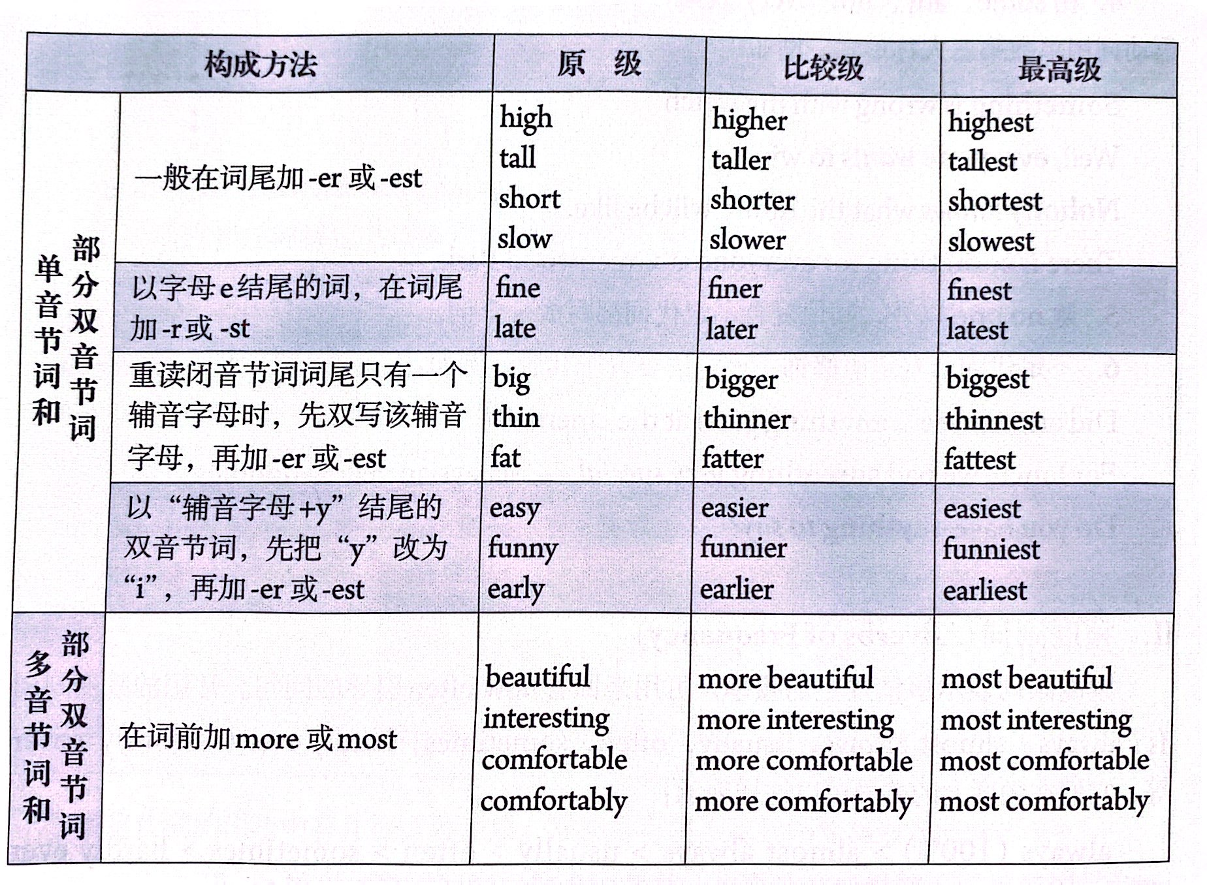
P114
形容词和副词比较级的规则变化规律

Slide 27
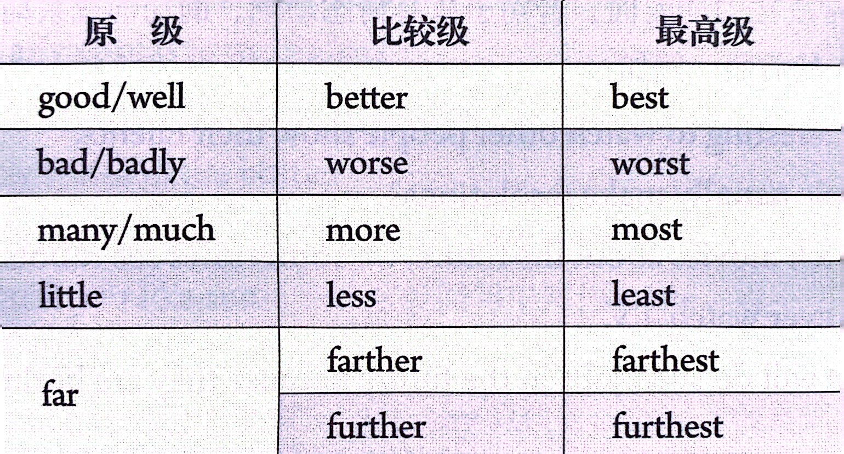
P114
形容词和副词比较级的不规则变化规律

Slide 28
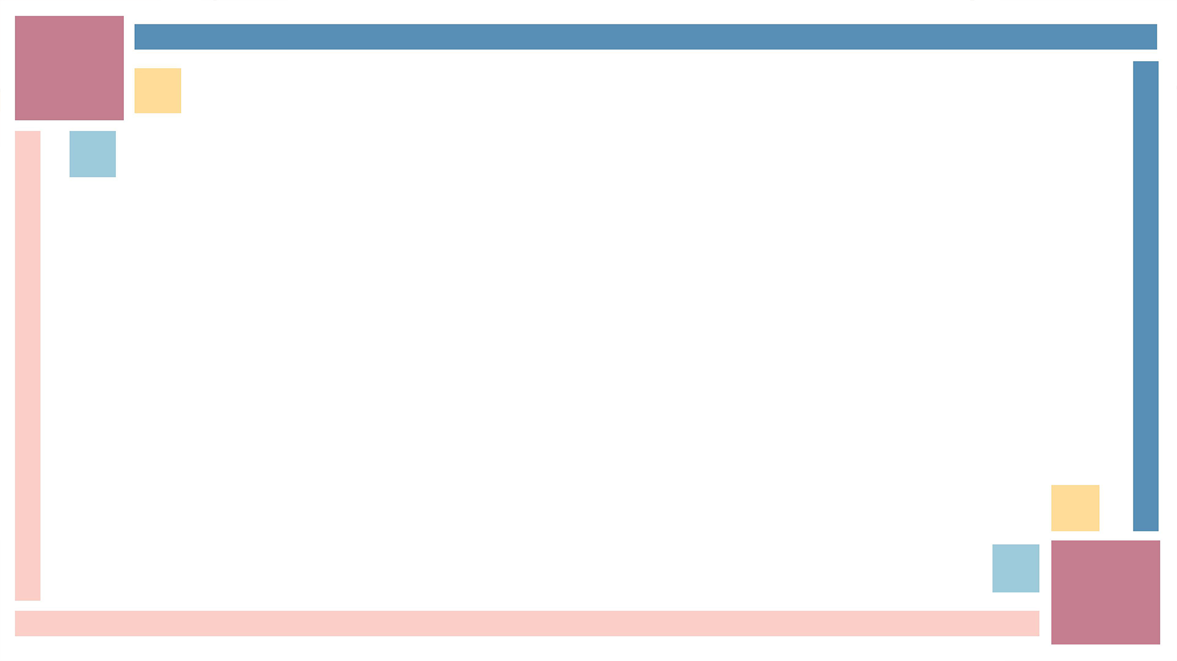

1. To be able to talk about personal traits (特征) and compare people.
—Is that…?
—No, that’s… She has longer hair than…
2. To learn some new words and useful expressions.

Slide 29


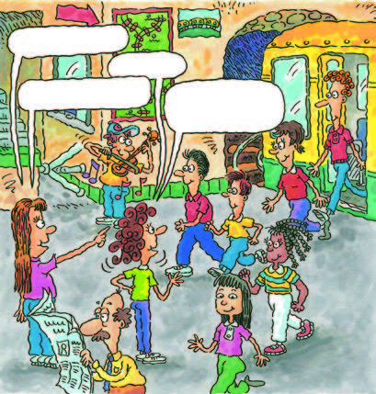
What does he/she look like?
build
height
tall
medium
height
short
heavy
thin

Slide 30
What does he/she look like?
long hair
short hair
curly hair
straight hair
hair

Slide 31

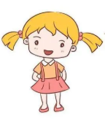
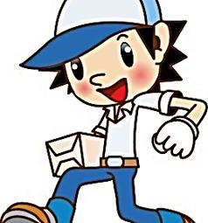
What does he/she wear?
wears glasses
wears a hat
wears a yellow T-shirt

Slide 32
loudly adv. 喧闹地；大声地；响亮地
quietly adv. 轻声地；轻柔地；安静地
e.g. Don’t talk so loudly.
不要这么大声说话。
All the students are sitting quietly in the library.
所有的学生都安静地坐在图书馆里。

Slide 33
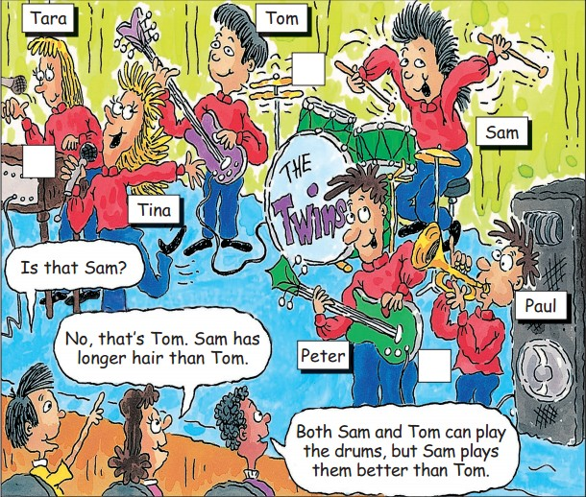

Who is heavier, Peter or Paul?
Who has longer hair, Tom or Sam?
Who sings more loudly, Tina or Tara?
Who is shorter and thinner, Peter or Paul?
Peter
Sam
Tina
Paul

Slide 34


Practice the conversation in the picture. Then make conversations about the other twins.
A: That’s Tara, isn’t it?
B: No, it isn’t. It’s Tina. Tina is taller than Tara. And she also sings more loudly than Tara.

Slide 35


形容词和副词的原级和比较级
原级，也就是原形。
比较级，“较……”，“更……”，用于两者之间比较。
原级 | 比较级
fast | faster
nice | nicer
thin | thinner
early | earlier
outgoing | more outgoing
规则变化

Slide 36
不规则变化
原级 | 比较级
good/well | better
bad/badly | worse
many/much | more
little | less
far | farther
 | further

Slide 37

Listen. Are the words in the box used with –(i)er or more? Complete the chart.
funny (run) fast
friendly (jump) high
outgoing (work) hard
hard-working (get up) early
smart
lazy

Slide 38
-er / -ier | more
friendly — friendlier | outgoing — more outgoing
funny — funnier
hard-working
— more hard-working
fast — faster
high — higher
hard — harder
smart — smarter
lazy — lazier
early — earlier

Slide 39
Listen. How are Tina and Tara different?
Fill in the boxes.
Tina … | Tara …
is more outgoing than Tara. | works as hard as Tina.
is friendlier and funnier than Tara.
gets up earlier than Tina.
can run faster and jump higher than Tara.
is smarter than Tara.
is lazier than Tara.

Slide 40



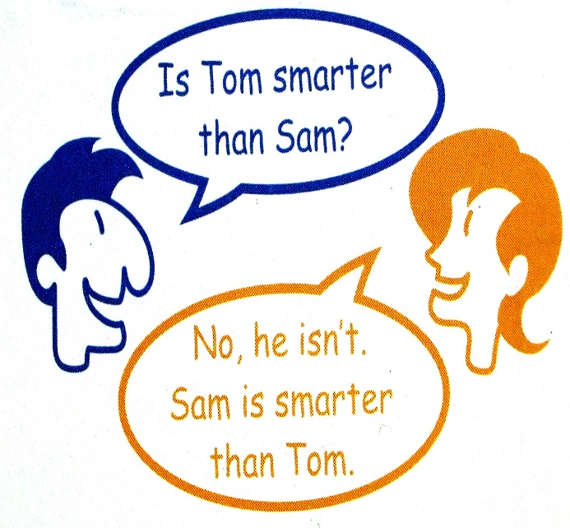
Student A, look at the chart on page 18. Student B, look at the chart on page 81. Ask and answer questions about Sam and Tom.

Slide 41
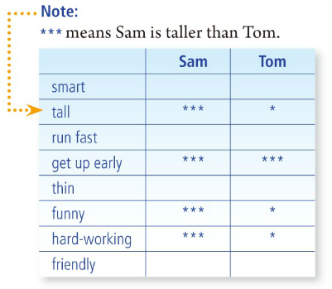
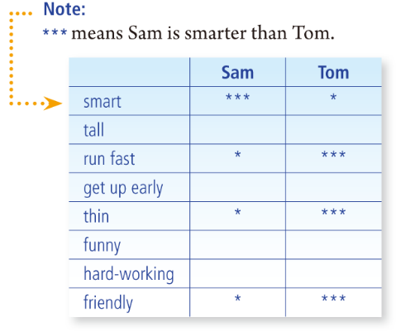

Slide 42
Is A smarter than B?
Is A taller than B?
Can A run faster than B?
Does A get up earlier than B?
Is A funnier than B?
Yes, he or she is./ No, he or she isn’t.
Yes, he or she can./ No, he or she can’t.
Yes, he or she does./ No, he or she doesn’t.

Slide 43

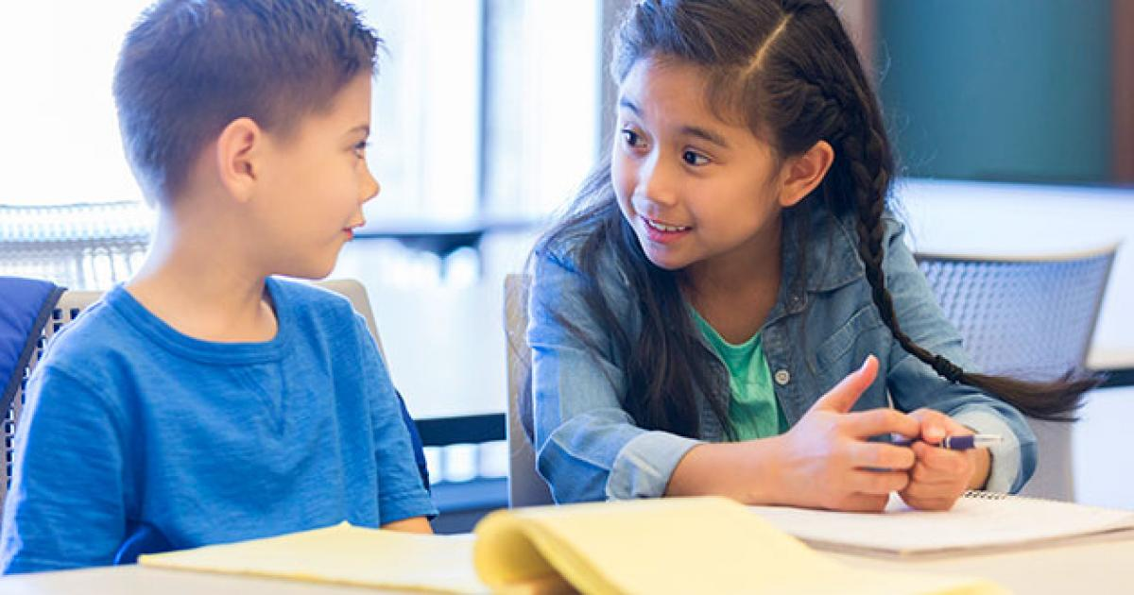
No, he isn’t. Sam is funnier than Tom.
Is Tom funnier than Sam?
Is Sam more hard-working than Tom?
Yes. He’s more hard-working than Tom.

Slide 45


1. Both Tom and Sam can play the drums, but Sam plays them better than Tom.
Tom和Sam都会打鼓，不过Sam比Tom 打得好。
both adj. & pron. 两个；两个都
作形容词，与复数名词连用，名词前还可加定冠词、指示限定词或形容词性物主代词。
作代词，在句中可作主语、同位语、宾语。
作同位语，多位于助动词和系动词之后，实义动词之前。

Slide 46
e.g. Both of them are right.
Helen doesn't know which hat is better; she'll buy both.
They both like going camping.
There are some trees on both sides of the river.
Both of them love reading.
= They both love reading.
—Which one do you like?
—I like both.

Slide 47
【拓展】
both ... and ... 既…… 又…… ；……和……都
连接两个并列成分。
当连接两个并列主语时，谓语动词用复数形式
e.g. He can both speak and write English.
Both Mike and I are happy.

Slide 48
【语境应用】完成句子。
1) 她的两本书都丢了。
_______ _______ books are lost.
2) 他们两个都是美国人。
_______ _______ _______ American.
3) Molly和Cindy都喜爱这部电影。
_______ _______ _______ _______ ________ the movie.
Both her
They are both
/ They both are
Both Molly and Cindy enjoyed
/ Molly and Cindy both enjoyed

Slide 49
4) 她既会唱歌又会跳舞。
She can _______ sing _______ dance.
5) Mr. Black想要见我们俩。
Mr. Black wanted to see _______ _______.
6) 我有两个妹妹，她们俩都性格外向。
I have two sisters. ______ ______ ______ are outgoing.
both and
us both
Both of them

Slide 50
better adj. / adv. (good和well的比较级)
较好的(地)；更好的(地)
e.g. The red bike is better than the blue one.
红色的自行车比蓝色的好。
Mike can play the guitar better than Bob.
Mike弹吉他比Bob弹得好。

Slide 51
2. Well, I’m more outgoing than Tara.
哦，我比Tara更外向一些。
outgoing adj. 友好的；外向的
e.g. Mary is an outgoing girl. Mary是一个外向的女孩。
My brother is not very outgoing.
我弟弟不善与人交往。

Slide 52
3. Tina thinks she works harder than me, but I work as hard as Tina.
Tina 认为她比我刻苦，但是我和她一样的刻苦。
as ... as ... 像 / 和……一样……
两个as中间用形容词或副词的原级。
e.g. The bag is as expensive as that one.
这个包和那个包一样贵。
Li Ling sings as well as Lucy.
李玲和Lucy唱得一样好。

Slide 53
as ... as ...的否定形式为not as / so ... as ...， “不像……那样……”。
e.g. My computer is not as / so good as hers.
我的电脑不如她的好。
Tom doesn’t jump as / so high as Jim.
Tom跳得不如Jim高。

Slide 54
4. You can tell that Lisa really wanted to win, though.
不过你能看得出来Lisa确实想赢呢。
win v. (won, won) 获胜； 赢；赢得
宾语通常是比赛、比赛的名次或奖品、战斗、战争、金钱等
e.g. I never win at cards. 我打牌从来不会赢。
When did you win the gold medal?
你什么时候获得金牌的？
That kind of behavior won’t win you any friends.
那样的行为不会让你交上任何朋友。

Slide 55
【语境应用】完成句子。
1) Jim _______ _______ _______(赢了比赛) easily.
2) Bill is _______ _______ _______(一定能赢).
3) Who _______ _______ _______(赢得第一名) in the swimming competition?
4) Anna _______ _______ _______(赢得一千元) in the boat race last week.
5) Peter tried his best to _______ _______ _______(赢得一场旅行) to Hawaii.
won the game
sure to win
won first place
won 1,000 yuan
win a trip

Slide 56
though adv. 不过；可是；然而
通常用于句末，前面用逗号与句子其他部分隔开
though conj. 虽然；尽管；不过
引导让步状语从句，可与although互换，也可与but引导的分句互相转换
e.g. It sounds like a lot of fun. Isn't it really dangerous though?
听上去很有趣，可是这不是也很危险吗？
e.g. They're coming next week, though I don't know which
day. 他们下周要来，但我不知道是哪天。

Slide 57
【语境应用】完成句子。
1) 这是件艰难的工作，可是我还是喜欢它。
It's hard work, ____________________.
2) 她虽然累了，但她还是继续跑。
She still kept on running, ____________________________.
I enjoy it, though
/ but I enjoy it
though / although she was tired

Slide 58
5. But the most important thing is to learn something new and have fun.
但最重要的事情是能学点新东西，并且享受这个过程。
have fun 玩得开心
have fun doing sth. 做某事很开心
= have a good / great time doing sth.
e.g. I have fun / a good time living with my grandparents.
我和爷爷奶奶住在一起很开心。

Slide 59
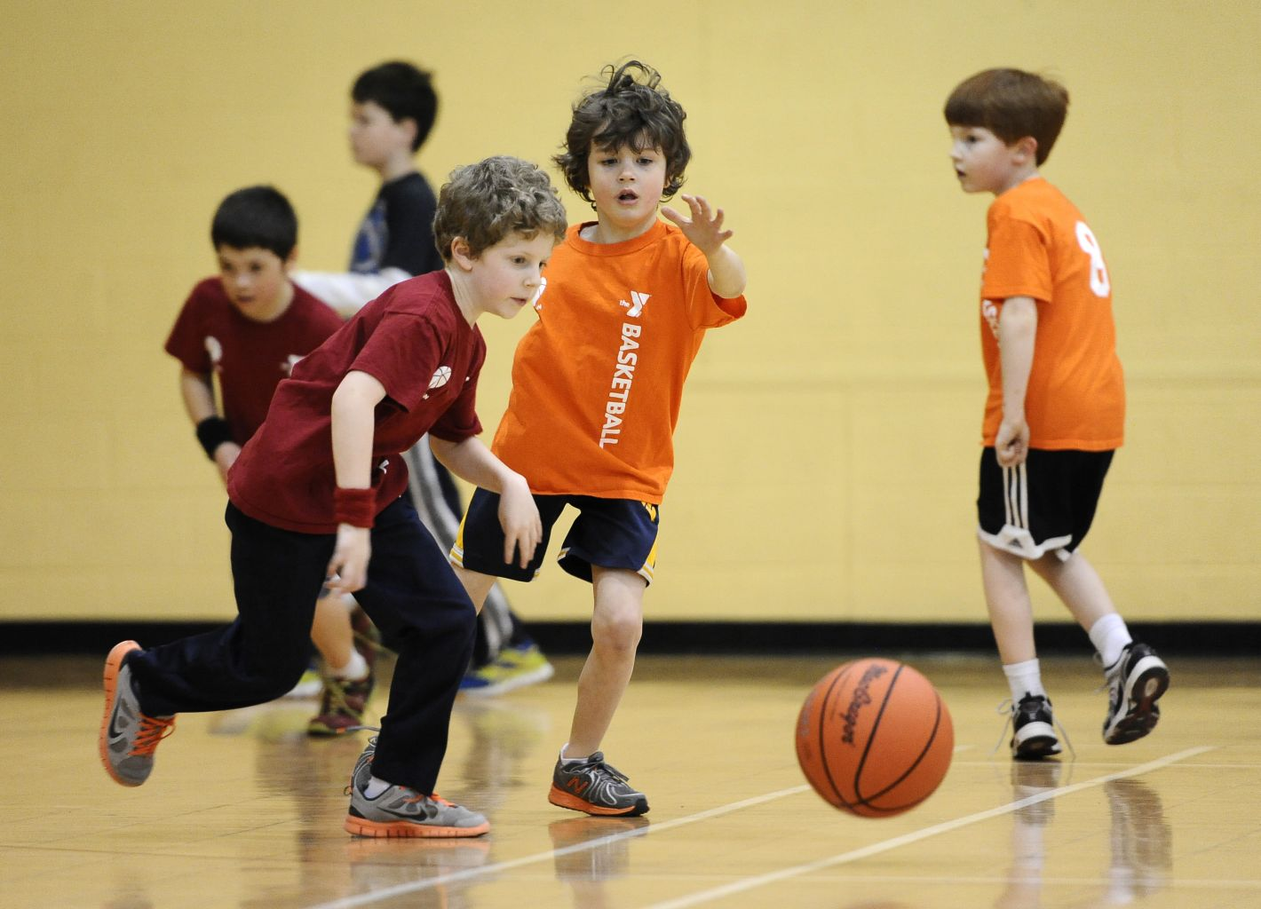
【语境应用】完成句子。
他们正在开心地打篮球。
They are _____________________________________
_____________________________________________.
having fun / a good time / a great time
playing basketball

Slide 60


打鼓
歌唱比赛
学一些新东西
玩得开心；过得愉快
play the drums
the singing competition
learn something new
have fun
附加疑问句：That’s Tara, isn’t it?
形容词和副词的比较级和原级：
Tina is taller than Tara.
I think Lisa sang better than Nelly.
as … as

Slide 61


根据句意及所给首字母提示，补全所缺单词。
1. Sue didn’t want to wake anybody, so she walked into the room q .
2. She went out, t it was rainy.
3. I have two dogs and b are white.
4. Mark has to wear glasses to help him see c .
quietly
though
both
clearly

Slide 62
5. Frank went on a trip with his family. They had a
f time together.
6. He spoke so l that all the students in the classroom could hear him.
7. Nelly was a lazy child in the past, but now she is very
h at school.
8. As a result, Class Six w the basketball game.
fantastic
/ fun
loudly
hard-working
won

Slide 63
II. 根据句意及所给汉语提示，写出所缺内容，每空一词。
1. Who is _______ _______ _______(敲鼓) now?
2. Lucy sings _______ _______ _______(和……一样好) her mom.
3. We _______ _______(玩得开心) riding our bicycles to the beach yesterday.
4. Mary came first _______ _______ _______ ____________(在写作比赛中).
5. I want to take guitar lessons and _______ ___________ ______ (学一些新东西).
playing the drums
as well as
had fun
in the writing competition
learn something new

Slide 64


1. Study the grammar on Page 113-115 of Comparative Forms of Adjectives and Adverbs.
2. Write three sentences about the differences between you and your partner.

